Slide 1
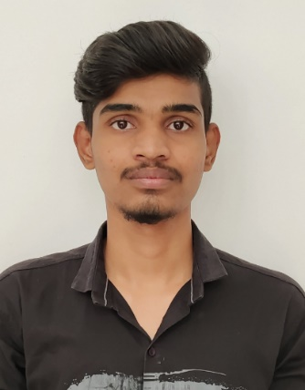
HIDING MESSAGE IN AN IMAGE
Name | : | KARTHIK KUMAR YADAV SADARI
SkillsBuild Email ID | : | karthiksadari@gmail.com
College Name | : | JNTUA College of Engineering Kalikiri
College State | : | Andhra Pradesh
Internship Domain | : | Cyber Security
Internship Start Date | : | 13th October 2023
Internship End Date | : | 26th November 2023

Slide 2
Problem Statement
In today's digital age, secure communication is of paramount importance. The challenge lies in concealing the very existence of a secret message within an image, making it an attractive target for investigation.
Project Topic
Our project focuses on the fascinating field of image steganography, a technique that allows for the concealment of sensitive information within innocent-looking images. Through the use of various steganographic methods and tools, we explore how data can be hidden in images without arousing suspicion.

Slide 3
Agenda
In this presentation, we will explore the fascinating realm of image steganography, a technique for covertly embedding messages within digital images. Our journey begins with a problem statement, elucidating the importance of secure data concealment in today's digital landscape. We then introduce our project's topic and objectives, followed by an in-depth discussion of the methods, tools, and step-by-step processes employed in image steganography. We'll delve into challenges and ethical considerations while examining the security implications and potential applications of this technology. A live demonstration will showcase the practicality of hiding messages within images, and we'll share project findings and conclusions. To foster future research, we'll suggest areas for further exploration.

Slide 4
Project Overview
Purpose: This project aims to explore the world of image steganography to understand its potential applications in securing digital communication and data protection.
Scope: The project focuses on various steganographic techniques, practical implementation, and ethical considerations in hiding messages within digital images.
Objectives: Our key objectives include mastering steganographic methods, developing a practical steganography process, evaluating security implications, and suggesting future research directions.

Slide 5
Project Overview Contd..
Key Focus: The project places emphasis on balancing message concealment with image quality and addressing challenges in the field of image steganography.
Overall Goal: The overarching goal is to provide insights into the significance of steganography in safeguarding sensitive information and fostering future exploration in the domain.

Slide 6
Who are the End Users
Individuals and the general public
Businesses and corporations
Government agencies and military organizations
Law enforcement and investigative agencies
Cybersecurity professionals and information security experts
Researchers and academia
Software developers and security professionals
Media and creative industries

Slide 7
Solution
Our solution involves the development and practical implementation of various image steganography techniques, providing a means to securely hide messages within digital images.
We explore multiple steganographic methods, including LSB insertion, and more, to offer a comprehensive understanding of the technology
Value Proposition
Our project on "Hiding a Message in an Image (Image Steganography)" offers a valuable proposition that combines knowledge and practical application in the field of data security. Through a comprehensive exploration of image steganography techniques, we provide end users with the means to enhance data security and safeguard sensitive information from unauthorized access.

Slide 8
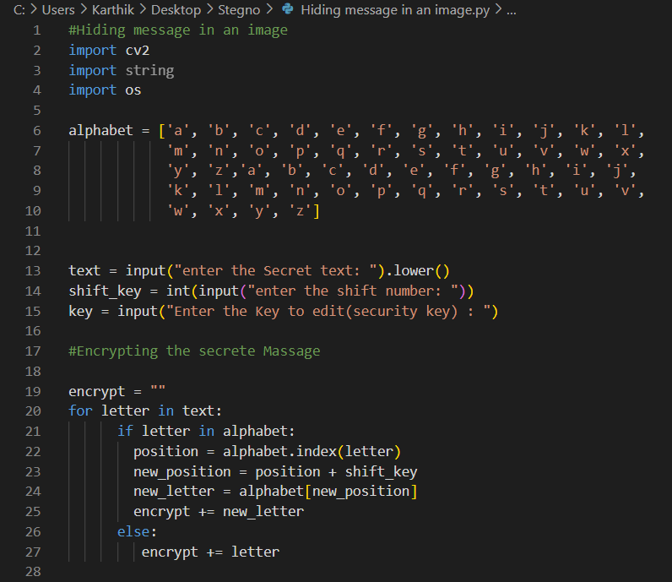
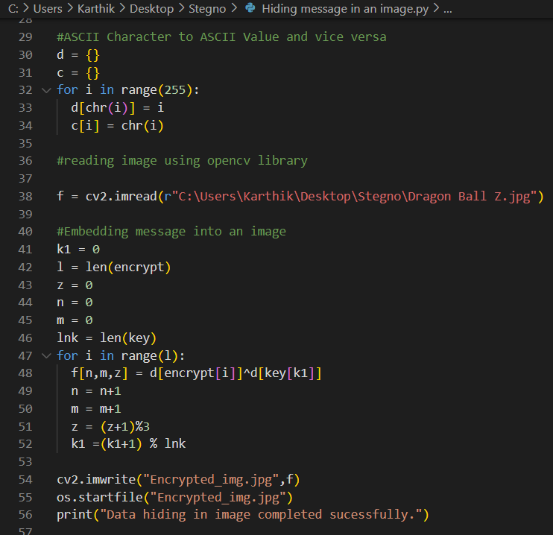
Modelling - Code

Slide 9
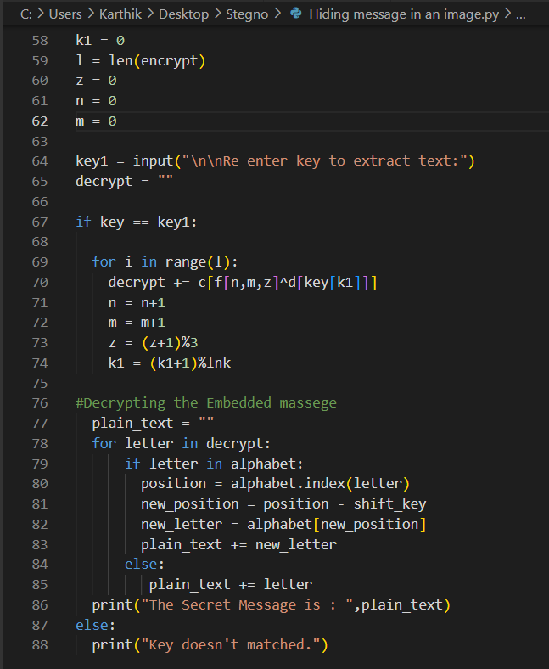
Modelling Contd..

Slide 10
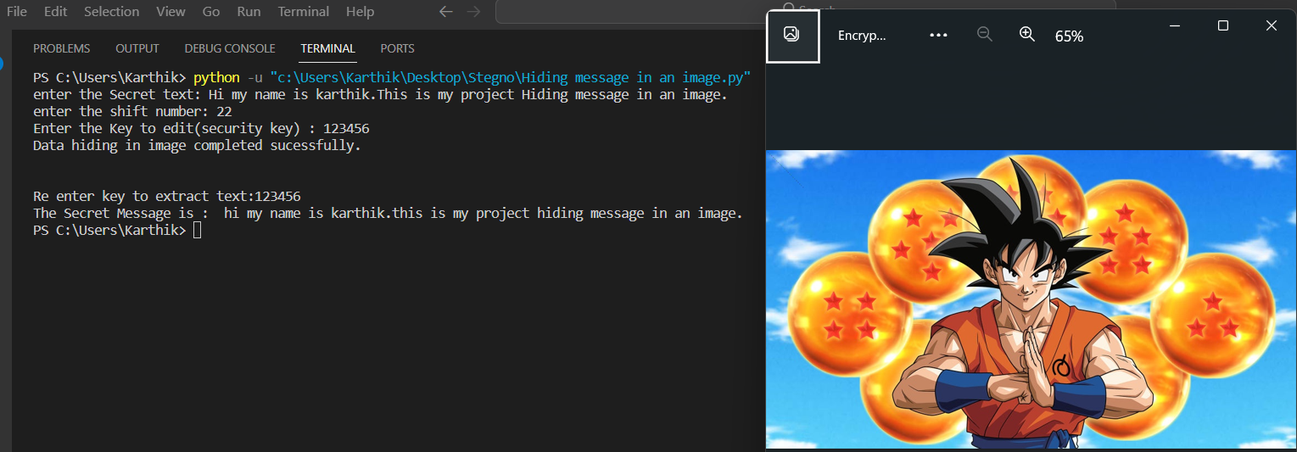
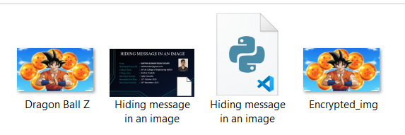
Result

Slide 11
Links
Repository :- https://github.com/KarthikSadari/Image-Steganography
Code:- Image Steganography.py
Output:- Image Steganography output
Image:- Image Source Link

Slide 12
Thank You

